Slide 1
Workshop on Tips and Tricks on working with PDFs.
9th March 2022
by
Dr. Pratik Hande

Slide 2
If you need to secure your PDF documents, iLovePDF’s Desktop app can facilitate this. Use the Protect PDF tool to password-protect sensitive information or apply the PDF to PDF/A function to preserve important documents long-term.
Go to Adobe’s PDF Combiner in a web browser. Adobe offers a free tool that allows you to easily merge PDF files in any browser.

Slide 3
To get started, visit https://www.adobe.com/acrobat/online/merge-pdf.html. If you’d rather not use Adobe’s official PDF Combiner, there are lots of third-party online tools you can use. Some popular options include:
I Love PDF: https://www.ilovepdf.com/merge_pdf
Smallpdf: https://smallpdf.com/merge-pdf
PDF2Go: https://www.pdf2go.com/merge-pdf
If you want to convert pdf to word document, use this tools in I love PDF , only click on PDF to Word , download your PDF then after commend your document is ready in Word .

Slide 4
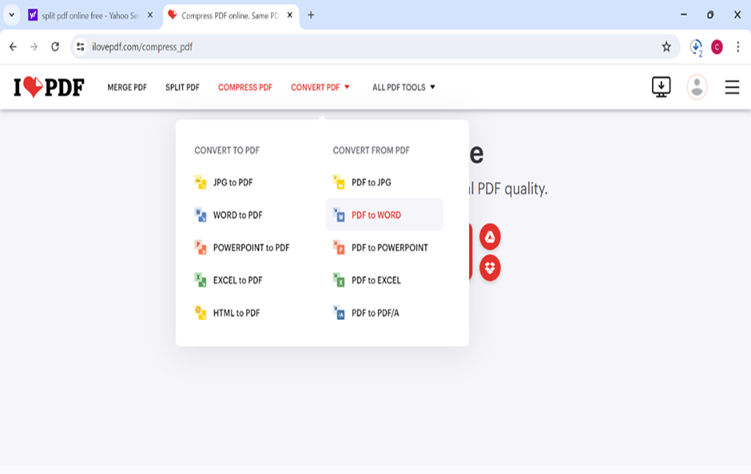

Slide 5
How to compress PDF file: select PDF file , then click on compress file, then file is ready in compressed

Slide 6
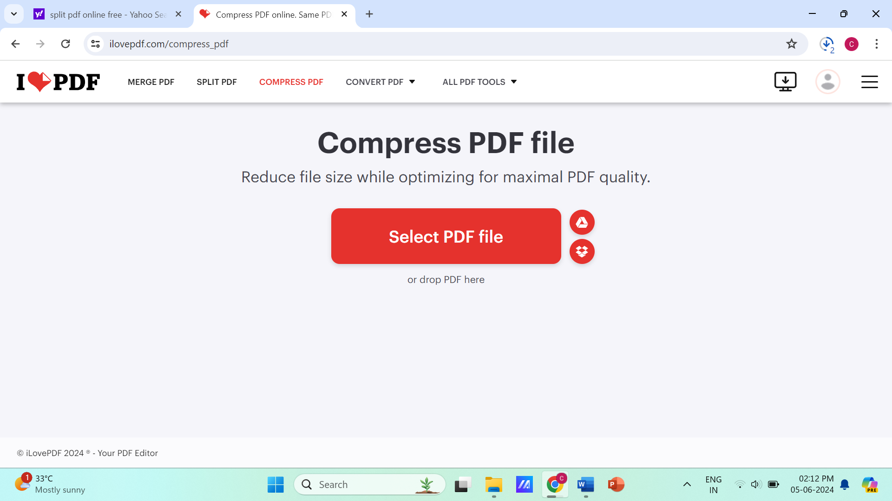

Slide 7
If you want to split PDF, select PDF file , or drop PDF in above Icon, click on it, and separate pages
according to your choice.

Slide 8
